Slide 1
WORKSHOP INTRO
4 × 4
Four themes · four lenses
16 short slides for the four topic pitches
Workshop objective
Turn priority questions into a clear mission, realistic targets, concrete outcomes and a lightweight roadmap to the end of 2028.
01
Annalisa
02
Simon
03
Gregor
04
Martin
Strategy, Governance
and Organisation
People, Skills and
Ways of Working
AI Applications and
Value Creation
Data, Technologies
and Infrastructure
Each topic is presented through the same four questions
01
Where are we
02
Trends
03
Proposed targets
04
Potential outcomes & actions
One slide per question keeps the 5-minute topic pitches simple, visual and easy to facilitate.
TG Digital Capabilities and AI · Copenhagen workshop
1

Slide 2
TOPIC 1
01 / 04
Strategy, Governance and Organisation
Strategic and organisational foundation for the other three topics
01
Where are we
Strategic and governance documents already exist in EU and outside, with a certain level of fragmentation
Guiding principles: how much data and AI one's overlap? Is it correct to consider AI simply “software”?
The advancements on strategy and governance maturity are diversified among member states
On Organization: not all the countries have a dedicated office for Digitalization and AI
WORKSHOP LENS
How the environmental matter is considered across present regulations?
Keep it practical · keep it shared
Where are we
Trends
Targets
Outcomes & actions
TG Digital Capabilities and AI · Copenhagen workshop
2

Slide 3
TOPIC 1
02 / 04
Strategy, Governance and Organisation
Strategic and organisational foundation for the other three topics
02
Trends
Technology goes faster than regulation
Overabundance of tools – that we use hapazardly
Once risks and challenges have been evaluated, regulations (Strategies and governance tools) are necessary
People, ethics and the environment are the three pillars on which a fair strategy could be based
WORKSHOP LENS
We need to organize tools and competencies, we need the roots for this fast-growing tree
Keep it practical · keep it shared
Where are we
Trends
Targets
Outcomes & actions
TG Digital Capabilities and AI · Copenhagen workshop
3

Slide 4
TOPIC 1
03 / 04
Strategy, Governance and Organisation
Strategic and organisational foundation for the other three topics
03
Proposed targets to be achieved
On strategy: Collecting the status and outlook of AI in environmental domain in Europe focusing on principles, ethics and environment
On governance: Understand how and in which measure Eionet can contribute with regulatory instruments to the European AI Strategy
On organisation: Filling gaps in Digital capabilities and AI application
WORKSHOP LENS
What two or three strategic changes should be visible by the end of 2028?
Keep it practical · keep it shared
Where are we
Trends
Targets
Outcomes & actions
TG Digital Capabilities and AI · Copenhagen workshop
4
Notes:
...
…
By mapping actual organization and needs in public administrations both in terms of existing structures and skills and propose relevant solutions to fill potential gaps.

Slide 5
TOPIC 1
04 / 04
Strategy, Governance and Organisation
Strategic and organisational foundation for the other three topics
04
Potential outcomes & actions
Shared AI-for-environment vision document presenting the current landscape, emerging trends, common needs and outlook towards 2028
Establishing an observatory on AI governance evolution for the environment
European environmental monitoring network to monitor AI and large computational facilities
...just to mention some :-)
WORKSHOP LENS
Do we want to share documents? Best practices? Experience and know-how?
Keep it practical · keep it shared
Where are we
Trends
Targets
Outcomes & actions
TG Digital Capabilities and AI · Copenhagen workshop
5
Notes:
…
2) ...monitoring, with an appropriate update frequency emerging issues, rising necessities and new states of the art. Checking principles, ethics and human centricity together with the environment
3) ...where existing environmental monitoring facilities serve the evaluation and mitigation of environmental impact and risks of large computational facilities and AI factories across Europe.

Slide 6
TOPIC 2
01 / 04
People, Skills and Ways of Working
Build practical capability through peer learning, shared resources and new working practices
01
Where are we
TG survey
  top priorities: Basic AI literacy · Knowledge sharing and capacity building · New Roles & responsibilities
  45–55% needing support
TG Workshop in June
  Basic literacy scales — domain skills do not
  The hard part: judging AI output, not using tools
Submitted Use Cases: SmartLab (DE), Teams Helpdesk (EEA)
WORKSHOP LENS
What do members need — and what can they already offer?
Keep it practical · keep it shared
Where are we
Trends
Targets
Outcomes & actions
TG Digital Capabilities and AI · Copenhagen workshop
6

Slide 7
TOPIC 2
02 / 04
People, Skills and Ways of Working
Build practical capability through peer learning, shared resources and new working practices
02
Trends
AI Act makes basic AI literacy a legal duty
Central training capacity often cannot or do not meet demand
New AI roles emerge — unplanned and unnamed
Existing roles change faster than job profiles
Fear of job loss is part of the conversation
WORKSHOP LENS
What has to change in how we work, not just in what we know?
Keep it practical · keep it shared
Where are we
Trends
Targets
Outcomes & actions
TG Digital Capabilities and AI · Copenhagen workshop
7

Slide 8
TOPIC 2
03 / 04
People, Skills and Ways of Working
Build practical capability through peer learning, shared resources and new working practices
03
Proposed targets to be achieved
A shared picture of what the network needs, who can help, and which AI roles exist where
A common AI literacy baseline every agency can point to
A peer-learning series that: X sessions by 2028, each leaving reusable material
WORKSHOP LENS
Which skills do agencies need to use AI responsibly and confidently by 2028?
Keep it practical · keep it shared
Where are we
Trends
Targets
Outcomes & actions
TG Digital Capabilities and AI · Copenhagen workshop
8

Slide 9
TOPIC 2
04 / 04
People, Skills and Ways of Working
Build practical capability through peer learning, shared resources and new working practices
04
Potential outcomes & actions
Capability Map — who needs what, who can help, which roles exist where
AI Literacy Reference — what everyone should know, plus role-specific modules
Peer-Learning Series — X sessions by 2028, hosted by members themselves
WORKSHOP LENS
Start small: what could we actually run with voluntary contributions?
Keep it practical · keep it shared
Where are we
Trends
Targets
Outcomes & actions
TG Digital Capabilities and AI · Copenhagen workshop
9

Slide 10
TOPIC 3
01 / 04
AI Applications and Value Creation
Prioritise concrete problems and expected value — not particular tools or technologies
01
Where are we
AI needs a solid data foundation to produce reliable and meaningful results – even with established standards, member states still provide their data in different forms and quality
various projects try to remedy this and build solutions for data harmonisation and mobilisation
Common AI strategy is missing from EU down to MS and organisational level
still strong dependency on (US or Chinese) vendors
WORKSHOP LENS
Which existing or proposed use cases are worth sharing?
Keep it practical · keep it shared
Where are we
Trends
Targets
Outcomes & actions
TG Digital Capabilities and AI · Copenhagen workshop
10

Slide 11
TOPIC 3
02 / 04
AI Applications and Value Creation
Prioritise concrete problems and expected value — not particular tools or technologies
02
Trends
industry is moving from individual vibe coded solutions towards agentic open platforms using protocols that AI agents understand (Agent2Agent protocols and Enterprise security policy and integration)
Local and open models gain traction and become more powerful, also vendor-supported (Gemini, Qwen,…) solutions
Hardware (NVIDIA, Apple) is moving AI capabilities from the data center to the edge -> independence and privacy.
WORKSHOP LENS
How do we distinguish interesting demos from scalable value?
Keep it practical · keep it shared
Where are we
Trends
Targets
Outcomes & actions
TG Digital Capabilities and AI · Copenhagen workshop
11

Slide 12
TOPIC 3
03 / 04
AI Applications and Value Creation
Prioritise concrete problems and expected value — not particular tools or technologies
03
Proposed targets to be achieved
identify limits and barriers to AI adoption in your current environment, considering:
  AI policies (too restrictive or too broad?)
  Data management (silos or APIs? Formats?)
  Inhouse AI competency and current efforts
Picture a realistic framework (organisational and practical) for AI adoption and productive use in the next 2-3 years
WORKSHOP LENS
What should Eionet be able to compare and prioritise consistently?
Keep it practical · keep it shared
Where are we
Trends
Targets
Outcomes & actions
TG Digital Capabilities and AI · Copenhagen workshop
12

Slide 13
TOPIC 3
04 / 04
AI Applications and Value Creation
Prioritise concrete problems and expected value — not particular tools or technologies
04
Potential outcomes & actions
established organisational policies that enable productive but safe use of AI
Inhouse exchange regarding needs, efforts and solutions
Identify 2-3 prime use cases (end-to-end) that could act as a best practice example
Collect lessons learned, engage in active exchange between EIONET and inhouse AI practitioneers and stake holders
WORKSHOP LENS
Which common template or framework would save members time?
Keep it practical · keep it shared
Where are we
Trends
Targets
Outcomes & actions
TG Digital Capabilities and AI · Copenhagen workshop
13

Slide 14
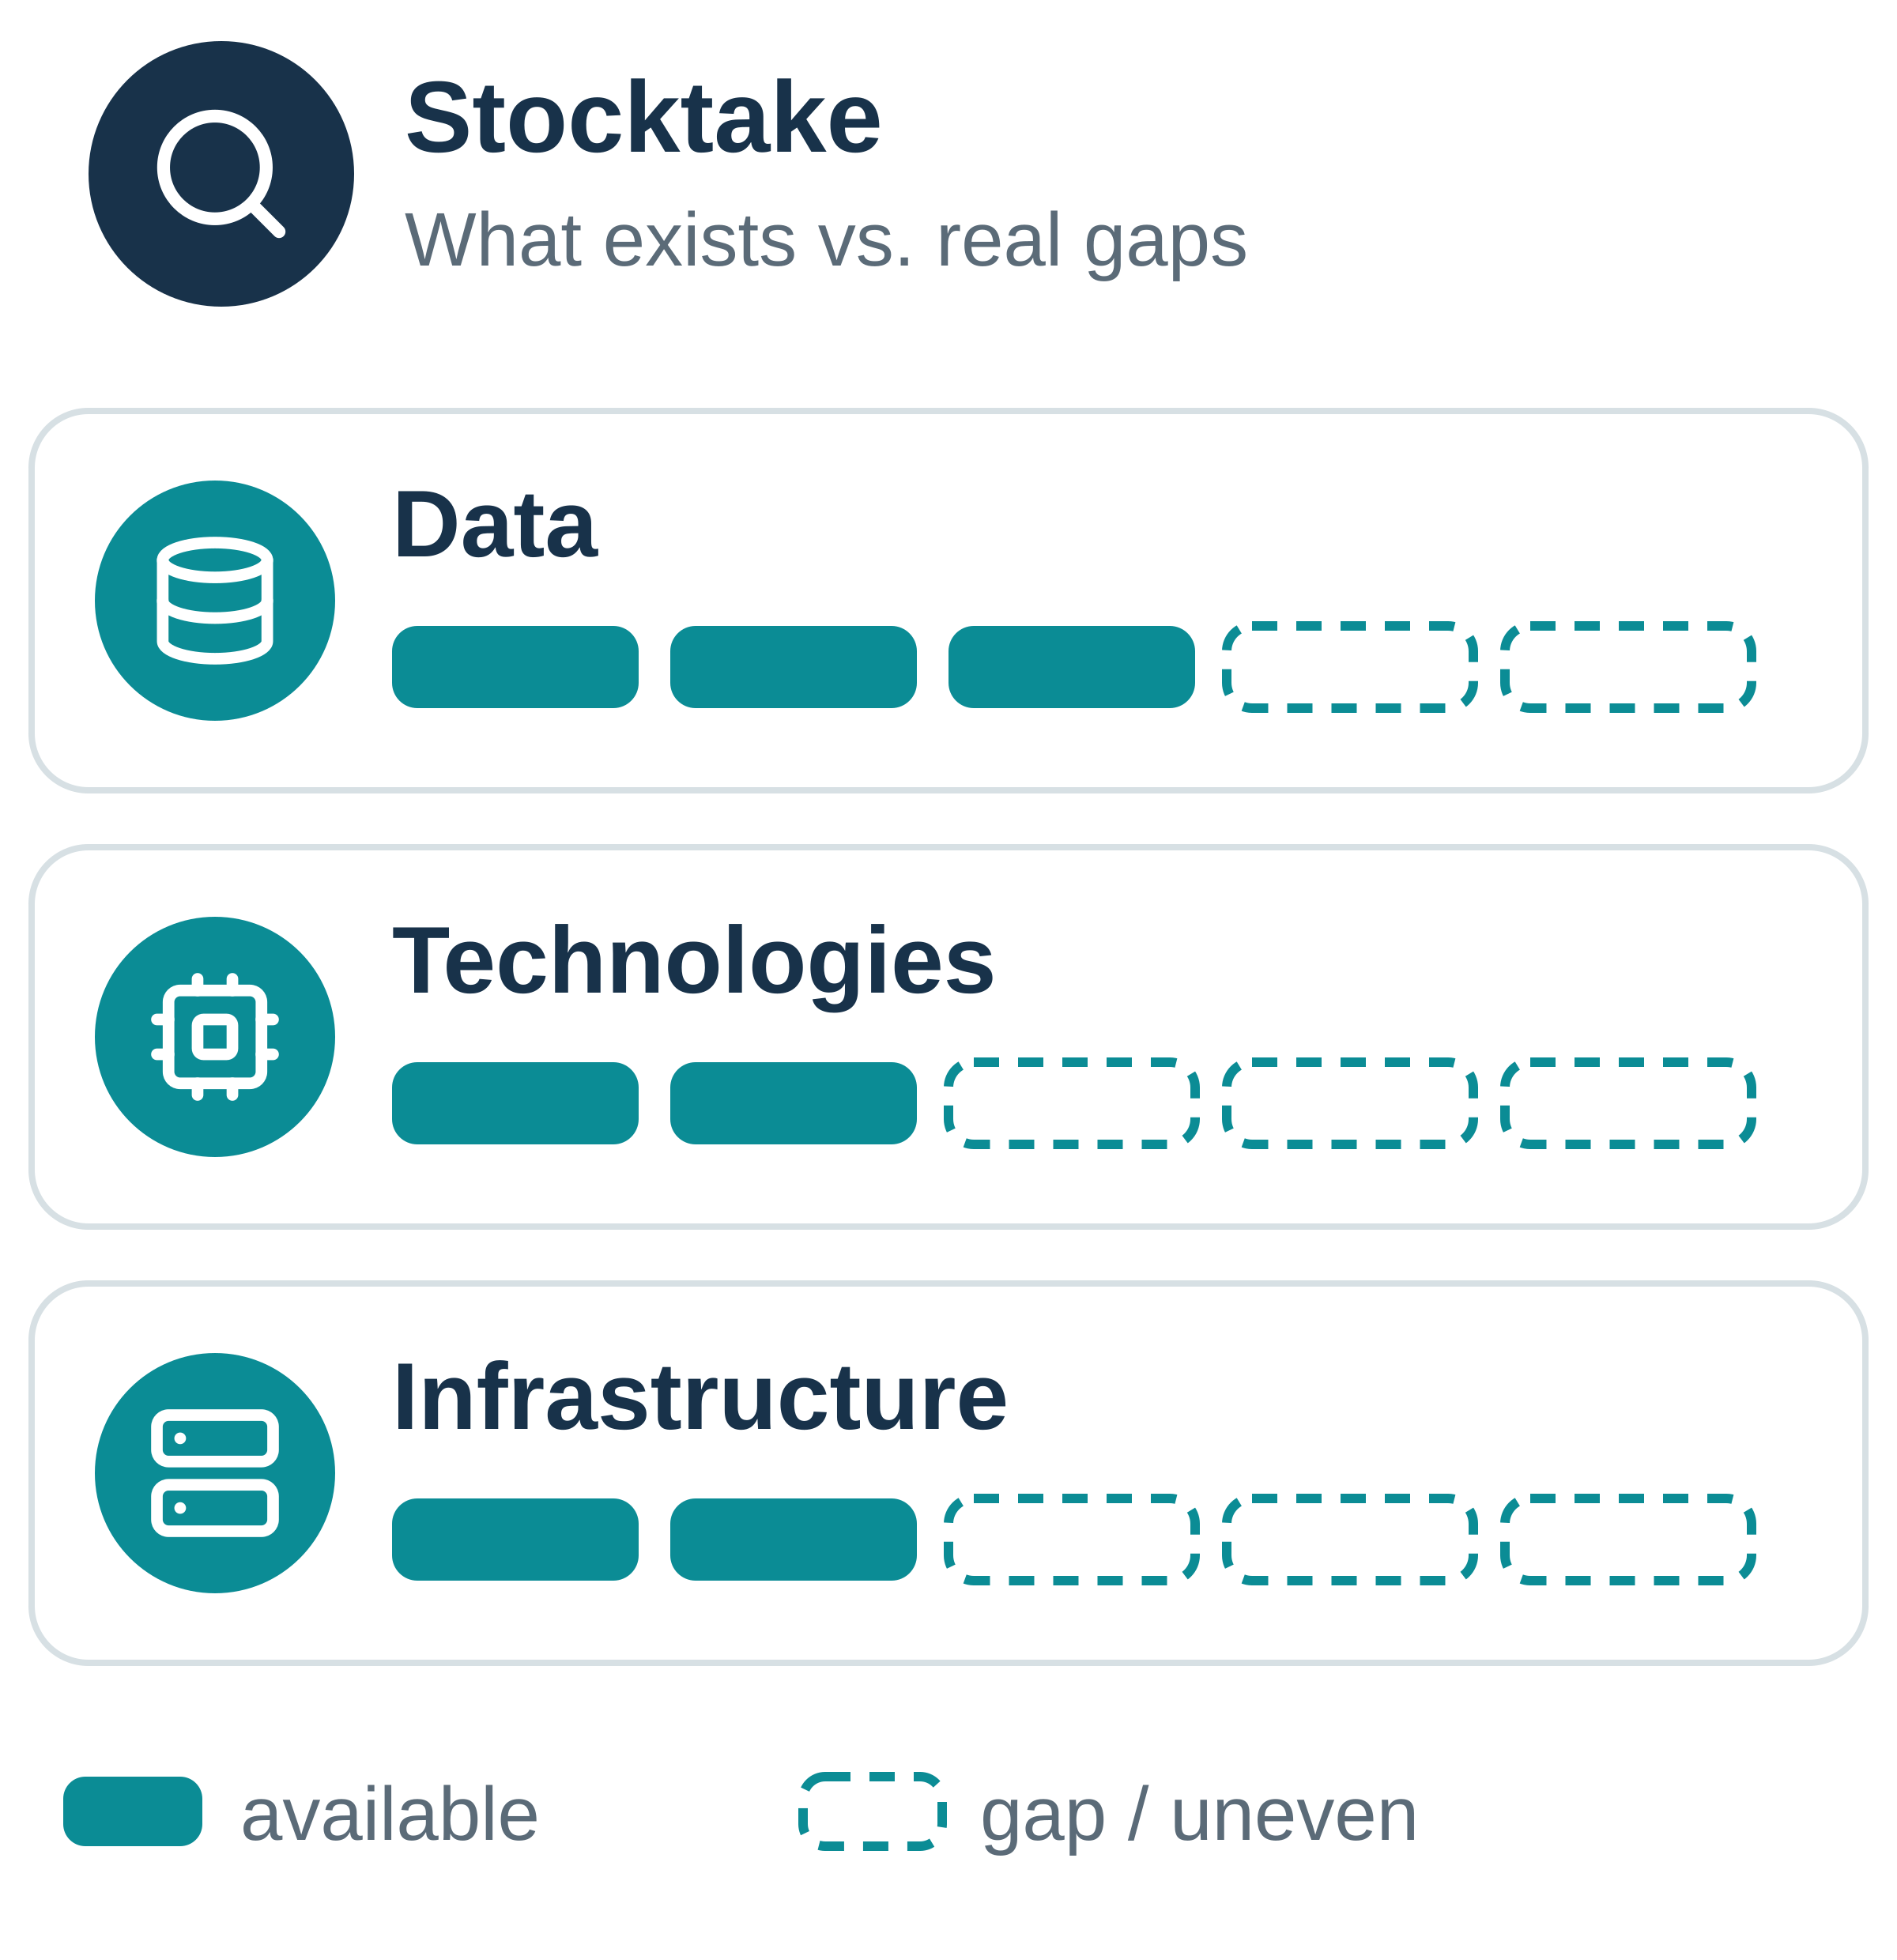
TOPIC 4
01 / 04
Data, Technologies and Infrastructure
Create the enabling conditions for useful, responsible and reusable AI applications
01
Where are we
Data – Rich environmental data already exist (Eionet reporting, INSPIRE, Copernicus), but quality, documentation, licensing and AI-readiness vary widely. Controversial cases of data usage for model learning.
Technologies – Tools and models are adopted project by project; the link between use-case needs and what technologies can realistically deliver is often unclear. US models closed, Chinese are more open.
Infrastructure – Compute, platforms and deployment capacity are uneven on global, EU level; national and European assets are hard to discover, compare and reuse.
Where are we
Trends
Targets
Outcomes & actions
TG Digital Capabilities and AI · Copenhagen workshop
14

Slide 15
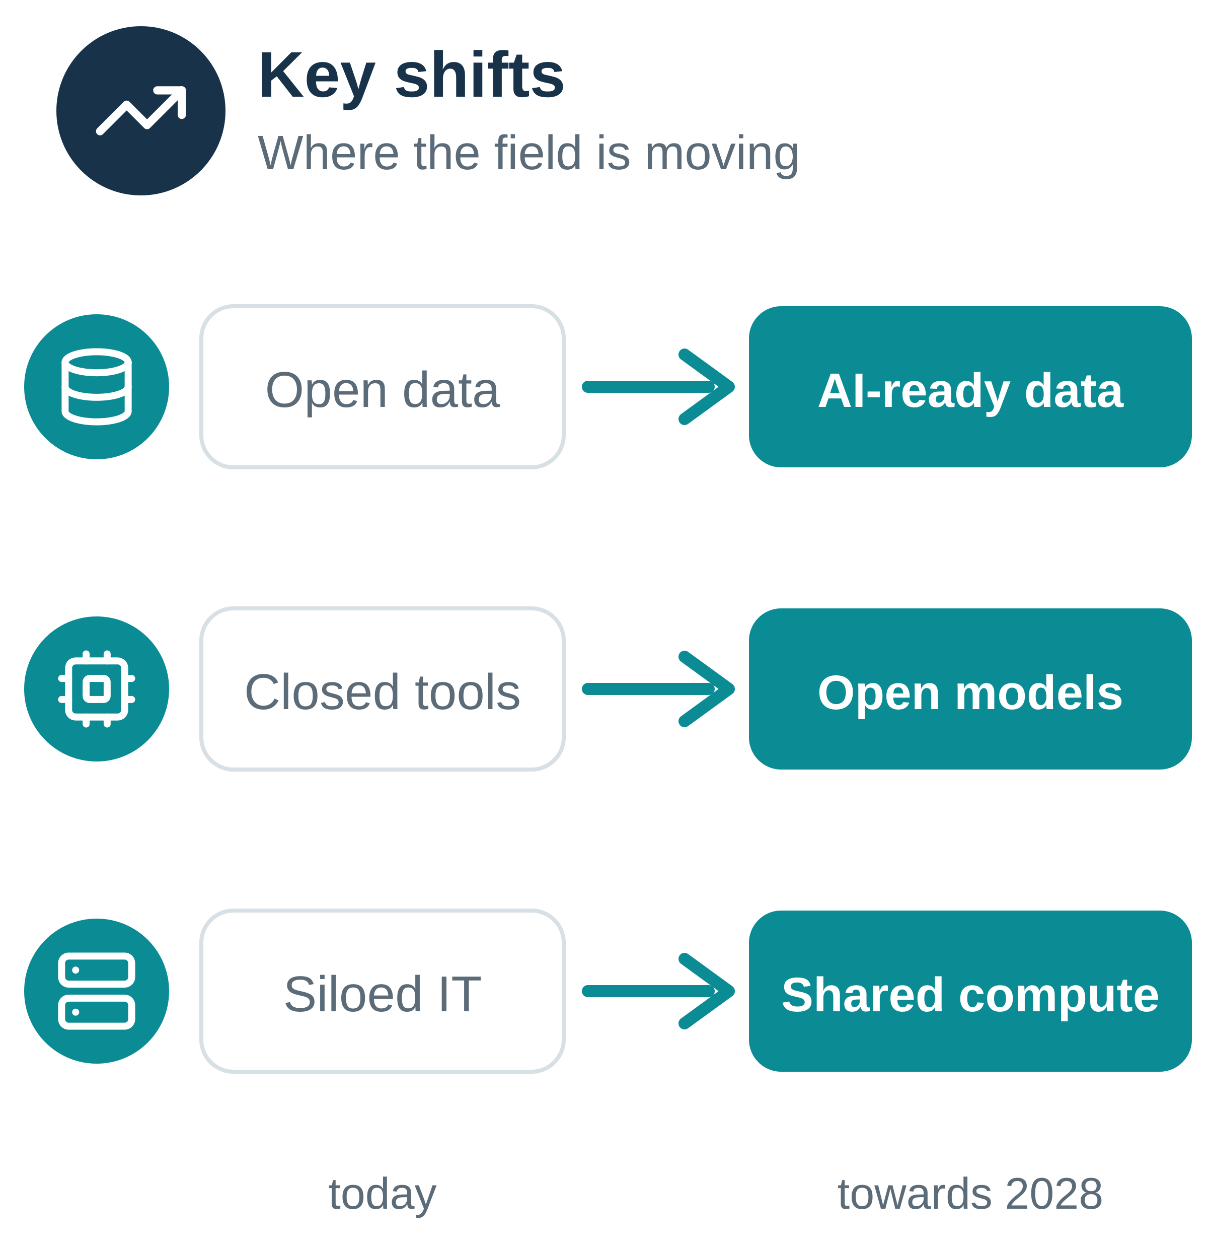
TOPIC 4
02 / 04
Data, Technologies and Infrastructure
Create the enabling conditions for useful, responsible and reusable AI applications
02
Trends
Data – The focus shifts from open data to AI-ready data: richer metadata, semantics and governance, with European data spaces setting common rules.
Technologies – Open and local models, Earth-observation foundation models and agentic tools on open protocols gain ground, reducing vendor lock-in.
Infrastructure – Shared cloud and HPC capacity grows (e.g. EuroHPC AI Factories, DestinE); security, sovereignty, lifecycle and energy use become core concerns.
Where are we
Trends
Targets
Outcomes & actions
TG Digital Capabilities and AI · Copenhagen workshop
15

Slide 16
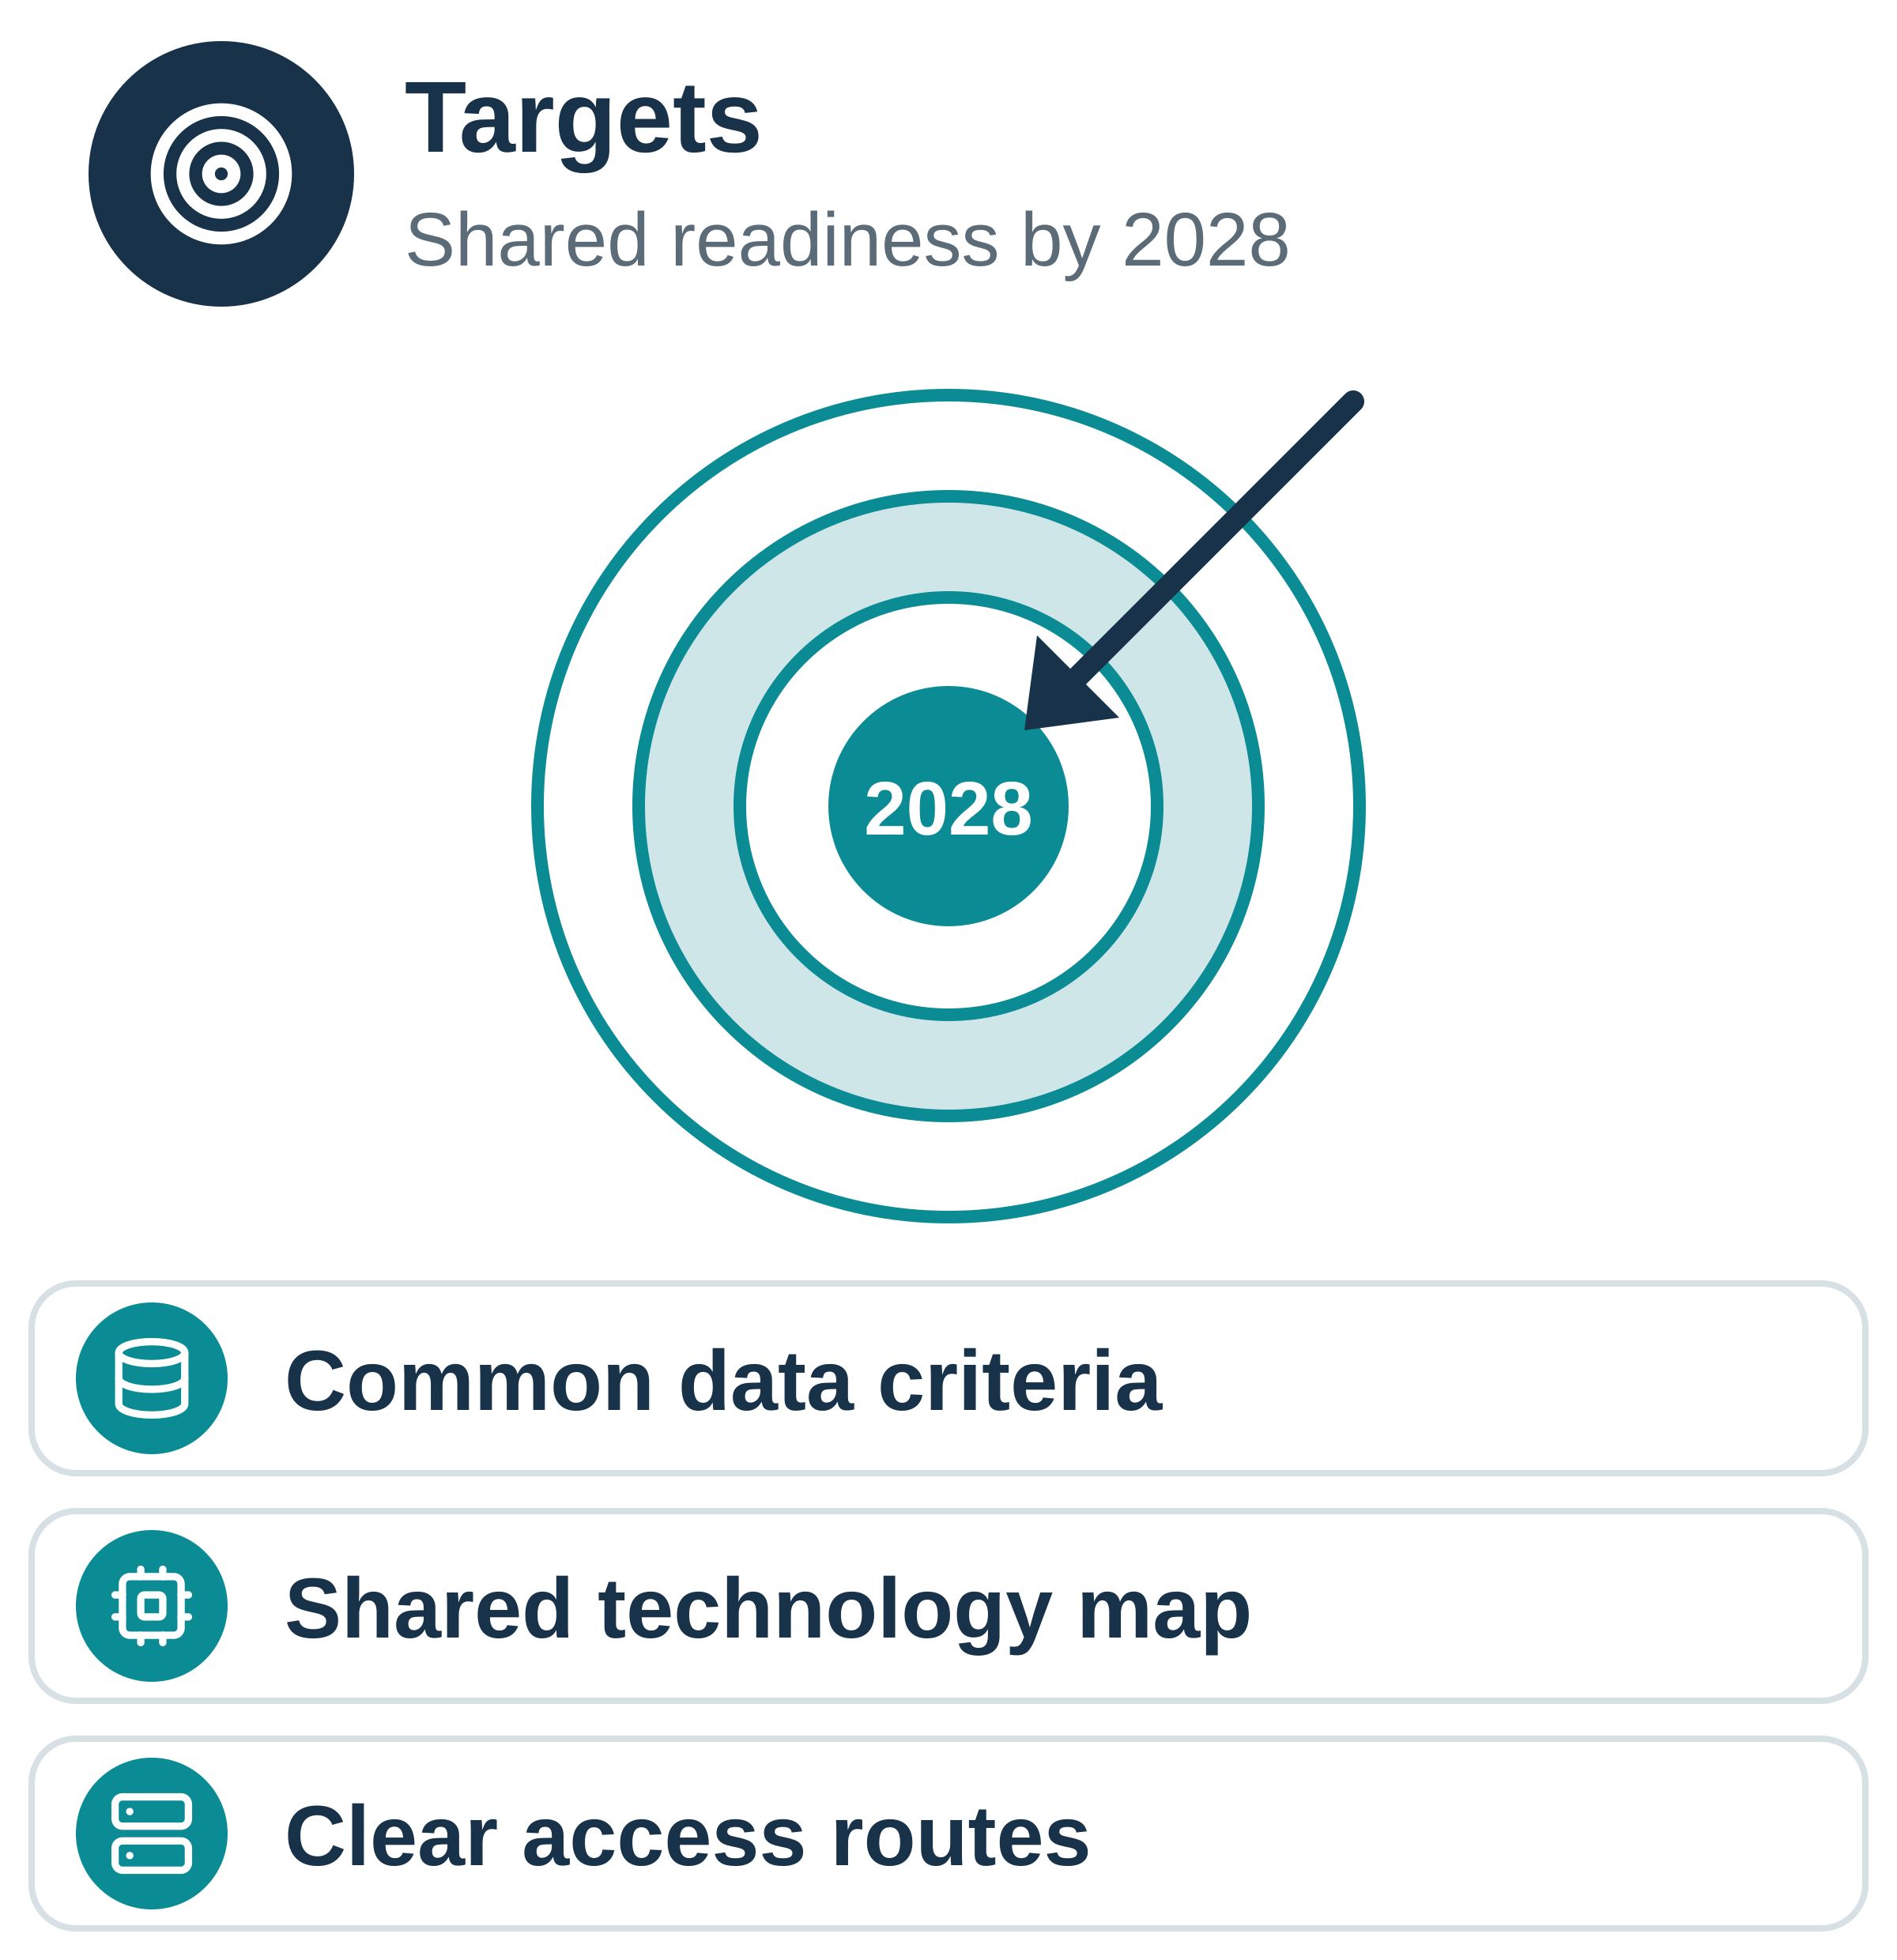
TOPIC 4
03 / 04
Data, Technologies and Infrastructure
Create the enabling conditions for useful, responsible and reusable AI applications
03
Proposed targets to be achieved
Data – TG can assess and improve the AI-readiness of their priority environmental datasets using a common, lightweight set of criteria.
Technologies – A shared view of proven technologies, standards and reusable components, mapped to priority use cases, so solutions are not reinvented.
Infrastructure – A clear picture of available national and European cloud, HPC and platform capacity, the main gaps, and realistic routes for members to access it.
Where are we
Trends
Targets
Outcomes & actions
TG Digital Capabilities and AI · Copenhagen workshop
16

Slide 17
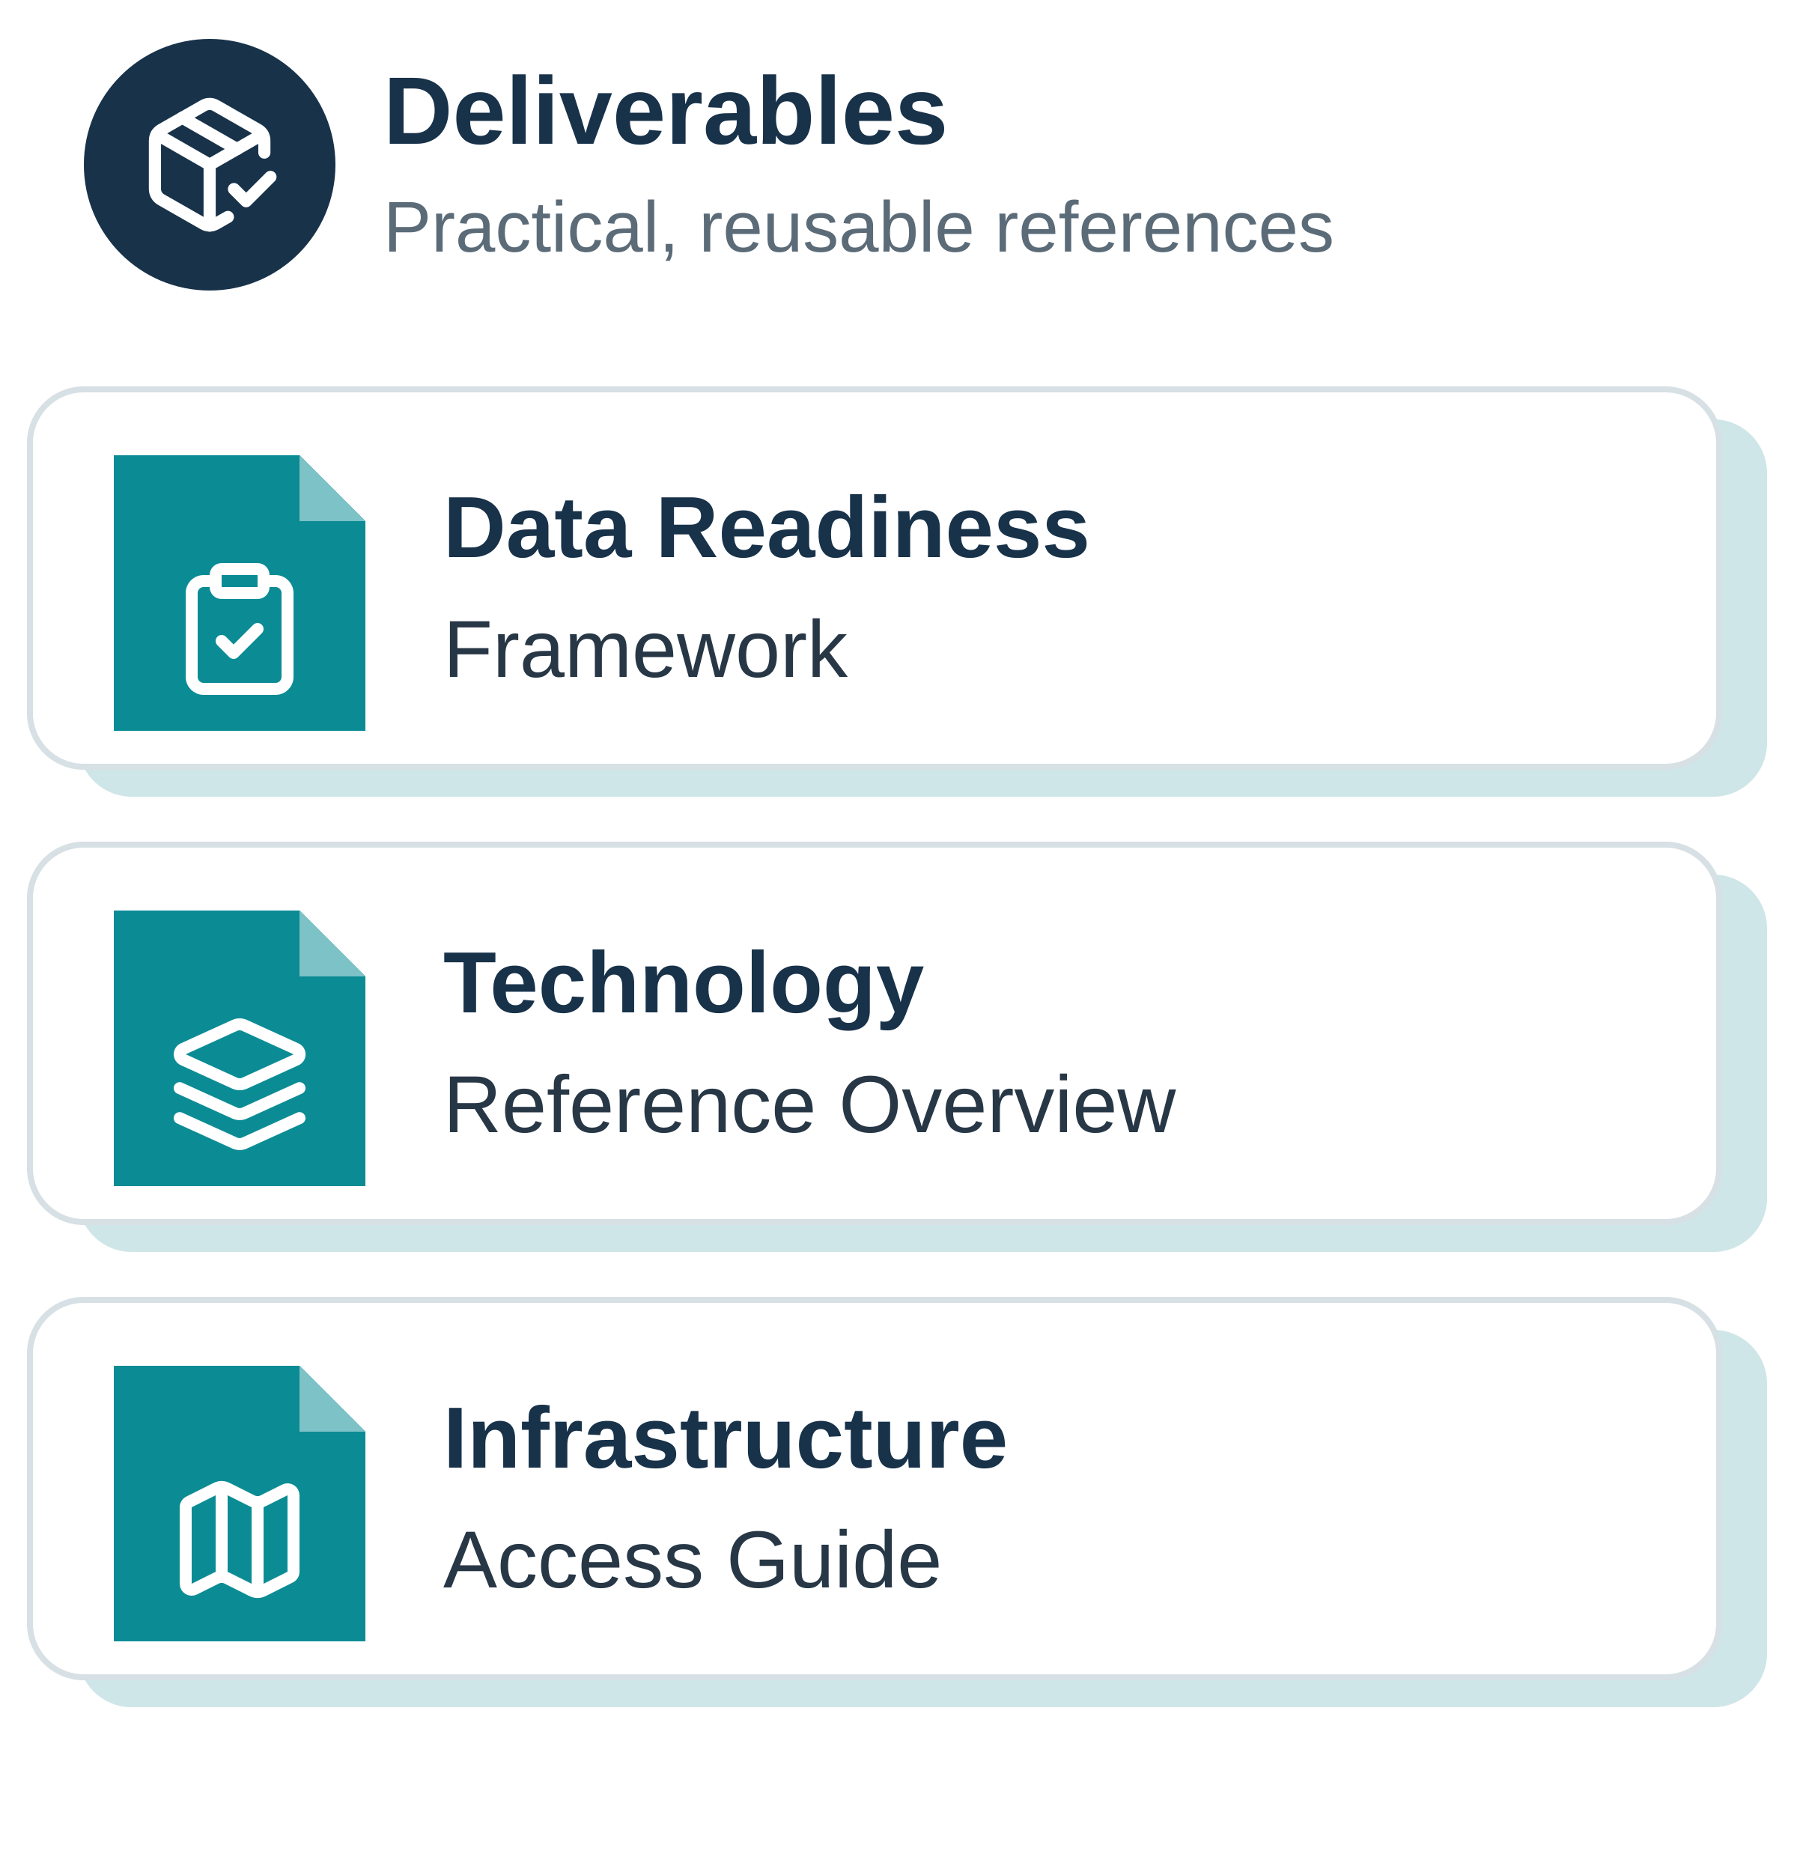
TOPIC 4
04 / 04
Data, Technologies and Infrastructure
Create the enabling conditions for useful, responsible and reusable AI applications
04
Potential outcomes & actions
Data – AI Data Readiness & Governance Framework: criteria, a simple self-assessment template and relevant examples for data assets.
Technologies – Technology Reference Overview: curated architectures, standards, models and reusable components, each linked to use cases where it works.
Infrastructure – Infrastructure Access Guide: national and European compute and platform options with access routes, conditions and members' lessons learned.
Where are we
Trends
Targets
Outcomes & actions
TG Digital Capabilities and AI · Copenhagen workshop
17

